Slide 1
ML PROJECT
HOTEL RESERVATION
VASUNDHARA SAXENA
ROLL NO – 57
REG NO - 12013828

Slide 2
INTRODUCTION
The hospitality industry has faced numerous challenges when it comes to managing hotel reservations and cancellations. A large percentage of hotel reservations are canceled, which results in lost revenue and operational inefficiencies. In this paper, we propose a machine learning model that can predict the likelihood of a reservation cancellation based on various factors such as the time of booking, room type, location, and rate plan.
Using this model, hotel managers can predict the likelihood of a reservation being canceled, allowing them to take proactive steps to reduce cancellations and minimize the impact on revenue and operations. The model can also be used to optimize pricing and room allocation strategies to reduce the likelihood of cancellations.
Overall, our machine learning model can provide valuable insights for the hospitality industry, helping hotels to manage their reservations more effectively and improve their bottom line.

Slide 3
ABOUT Dataset
Customer behavior and booking possibilities have been radically changed by online hotel reservation channels. Cancellations or no-shows cause a significant number of hotel reservations to be canceled. Cancellations can be caused by a variety of factors, such as scheduling conflicts, changes in plans, etc. In many cases, this is made easier by the possibility of doing so free or at a low cost, which is beneficial for hotel guests but less desirable and possibly revenue-diminishing for hotels.
As a data scientist, our job is to build a machine learning model to help the hotel owners better understand if the customer is going to honor the reservation or cancel it?
Link : https://www.kaggle.com/datasets/ahsan81/hotel-reservations-classification-dataset
PROBLEM STATEMENT
Can you predict if the customer is going to honor the reservation or cancel it??

Slide 4
LIBRARIES USED
PANDAS
MATPLOTLIB
Library used for data manipulation and analysis. The library provides easy-to-use data structures and data analysis tools for handling structured data, including tabular and time-series data.
The library provides a wide range of tools for creating various types of plots, including line plots, scatter plots, bar plots, histograms, and more.
NUMPY
SEABORN
The library provides powerful data structures, mathematical functions, and tools for working with multi-dimensional arrays and matrices. NumPy is the fundamental package for numerical computing in Python.
Python data visualization library based on Matplotlib that provides a high-level interface for creating informative and attractive statistical graphics

Slide 5
LIBRARIES USED
MISSINGNO
STATSMODEL.API AS SM
Python library used for visualizing missing data in datasets. It provides a range of tools for identifying missing data patterns and visualizing the completeness of the dataset. Missingno provides features such as heatmaps, bar charts, and matrix plots for visualizing the patterns of missing data.
Statsmodels is a Python library for statistical modeling and data analysis. It provides a range of tools for estimating statistical models, conducting statistical tests, and exploring data.
SKLEARN
Scikit-learn provides a range of tools for data preprocessing, feature selection, model selection, and evaluation. It also provides many machine learning algorithms, including linear models, decision trees, random forests, support vector machines, and neural networks.

Slide 6
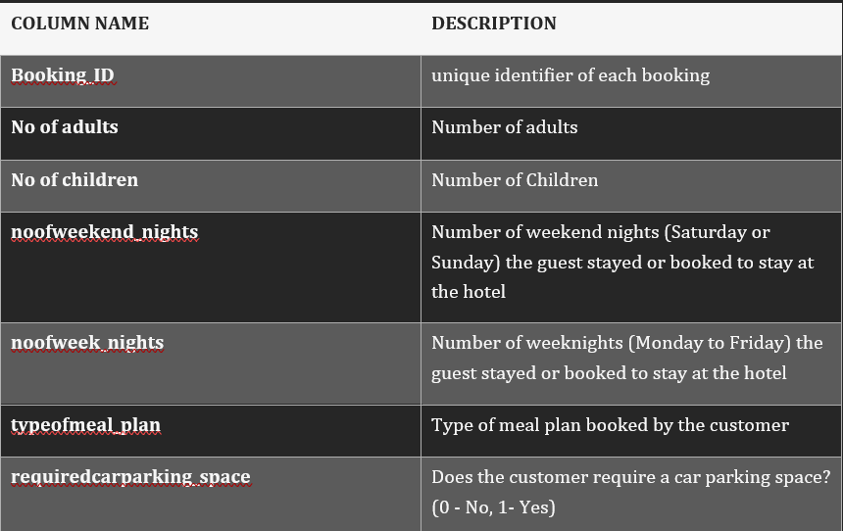
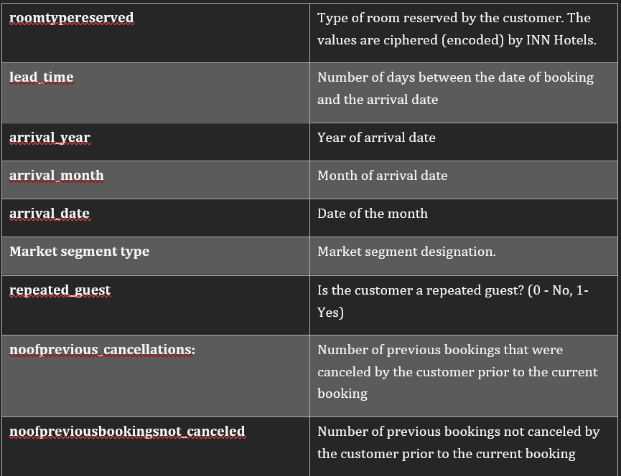
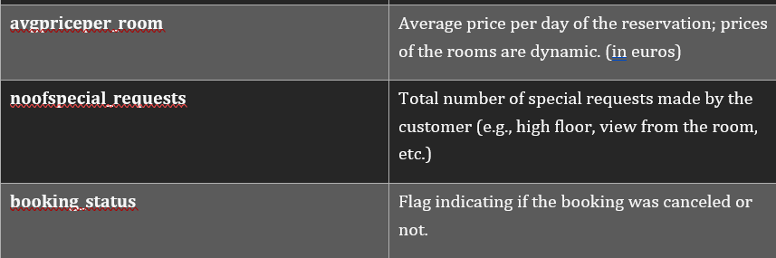
Dataset description

Slide 7

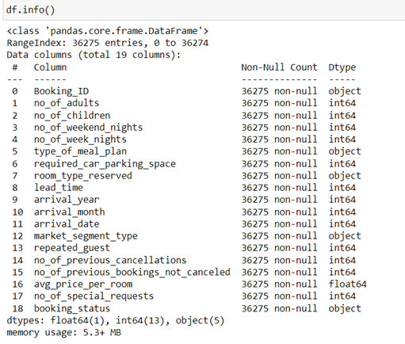
About dataset
The dataset has 36275 rows and 24 columns

Slide 8
Model evaluation criterion
Model can make a wrong prediction as:
Predicting a person will cancel a booking when a person does not cancel the booking (False Negative)
This will result in a loss of potential revenue and business for the hotel chain.
Predicting a person will not cancel a booking, when a person will cancel the booking (False Positive)
This will result in last minute cancellations loss revenue due to hiring of human resources for guests who will no longer come, as well as profit margin loss in case of trying to price the room cheap to get last minute bookings.

Slide 9
Model evaluation criterion
f1_score should be maximized, the greater the f1_score higher the chances of identifying both the classes correctly
The model_performance_classification_statsmodel function will be used to check the model performance of models.
The confusion_matrix_statsmodel function will be used to plot the confusion matrix.

Slide 10
observations
The F1 score on the training and testing sets are 0.843 and 0.845, which means model is showing generalized performance on the dataset.
Feature Selection for our project, we are trying to predict the cancellation status of a booking. After accessing the data, we found that is Canceled and Reservation Status are completely correlated with each other. When cancellation status is 0 then reservation status would be Checkout otherwise cancellation status would be 1. As only one prediction variable is needed, we decide to drop Reservation Status feature and use is Canceled as a binary label target.

Slide 11
VARIANCE_INFLATION_FACTOR:
The variance_inflation_factor() function from the statsmodels.stats.outliers_influence module is a tool for detecting multicollinearity in linear regression models. Multicollinearity occurs when there are high correlations among the independent variables in a linear regression model, which can lead to unreliable estimates of the regression coefficients and inflated standard errors.
The variance_inflation_factor() function calculates the variance inflation factor (VIF) for each independent variable in a linear regression model. The VIF is a measure of how much the variance of an estimated regression coefficient is increased due to multicollinearity. A VIF value of 1 indicates no multicollinearity, while values greater than 1 indicate increasing levels of multicollinearity.

Slide 12
Data preprocessing
StandardScaler
StandardScaler is a preprocessing class from the sklearn.preprocessing module in scikit-learn library that is used to standardize the data by scaling each feature to have a mean of 0 and a variance of 1. This transformation is also known as "standardization" or "Z-score normalization".
The StandardScaler class performs the following steps:
  Computes the mean and standard deviation of each feature from the training set.
  Subtracts the mean from each feature.
  Divides each feature by its standard deviation.

Slide 13
LabelEncoder
LabelEncoder is a preprocessing class from the sklearn.preprocessing module in scikit-learn library that is used to convert categorical labels (text-based) into numerical labels. This transformation is necessary for some machine learning algorithms that can only handle numerical data.
The LabelEncoder class performs the following steps:
  Assigns a unique integer to each unique category in the label column, starting from 0.
  Replaces the text labels with their corresponding integers.

Slide 14
train_test_split
train_test_split is a function in the Python library scikit-learn that is commonly used for splitting a dataset into two subsets: a training set and a testing set.
The purpose of splitting the data into these two sets is to be able to train a machine learning model on the training set and tests its performance on the testing set.
The train_test_split function randomly shuffles the data and splits it into two subsets based on a specified ratio, typically 70/30 or 80/20, where the larger subset is used for training and the smaller subset is used for testing.

Slide 15
Data preprocessing
accuracy_score: Computes the accuracy of the predicted values compared to the true values.
confusion_matrix: Computes a confusion matrix which is a table that summarizes the performance of a classification model.
roc_curve: Computes the Receiver Operating Characteristic (ROC) curve, which is a graphical representation of the performance of a binary classifier.
roc_auc_score: Computes the Area Under the ROC Curve (AUC-ROC), which is a measure of the performance of a binary classifier.

Slide 16
precision_score: Computes the precision of a classification model, which is the ratio of true positives to the total number of predicted positives.
classification_report: Generates a report that includes precision, recall, and f1-score for each class in a classification model.
recall_score: Computes the recall of a classification model, which is the ratio of true positives to the total number of actual positives.
f1_score: Computes the f1-score of a classification model, which is the harmonic mean of precision and recall.
precision_recall_curve: Computes the precision-recall curve, which is a graphical representation of the trade-off between precision and recall.

Slide 17
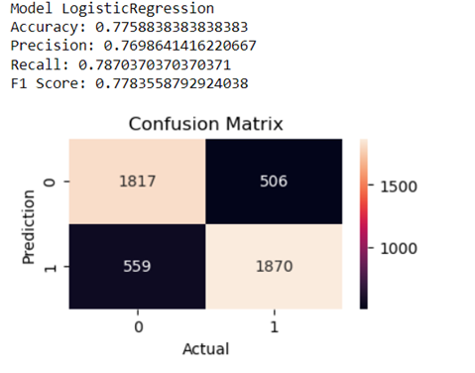
METHODOLOGIES
Logistic Regression (Baseline)
The baseline model is set as the benchmark for the performance comparison. Since this is a binary classification problem and logistic regression can map all data points into a value between 0 and 1 by the sigmoid function, then it’s used as the baseline model.
Package: sklearn.linear model.LogisticRegression

Slide 18
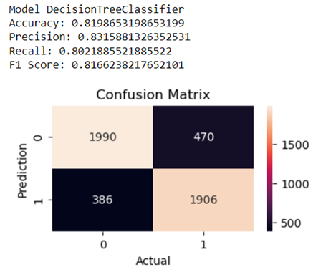
Decision Tree
The decision tree can break down the problem like binary classification into a bunch of subsets with homogeneous values. The splitting procedure is helpful to show the importance of each feature and thus provide us some insights.
Package: sklearn.tree.DecisionTreeClassifier

Slide 19
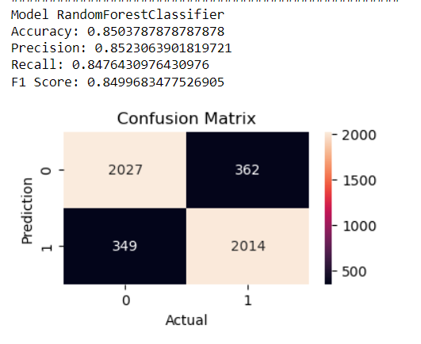
Random Forest
Random forest is an ensemble learning method which can be used for classification. It’s comprised by a multitude of decision trees but without the cost of the overfitting prone and thus may have higher accuracy than decision tree.
Package: sklearn.ensemble.RandomForestClassifier

Slide 20
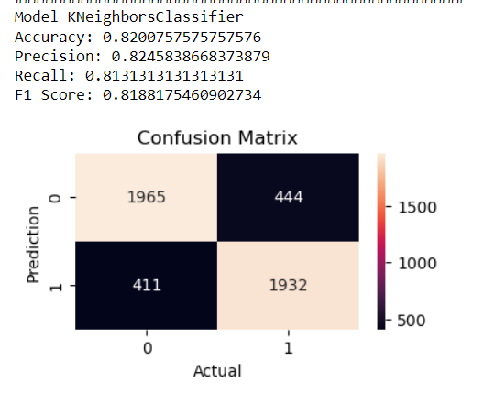
KNeighborsClassifier
Supervised machine learning algorithm used for classification and regression tasks. KNN is a non-parametric algorithm that works by finding the k nearest neighbors to a given data point in the feature space and then predicting the class of the new data point based on the classes of its nearest neighbors.
Package: sklearn.neighbors.KNeighborsClassifier

Slide 21
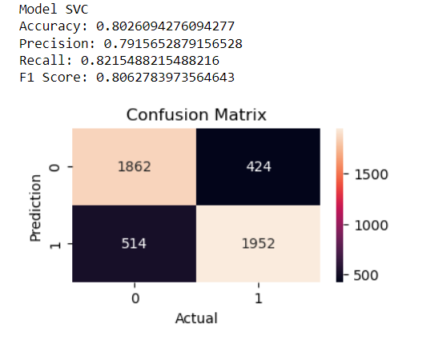
Support Vector Machine
Support vector machine is a good general-purpose classification algorithm. It aims to find the best decision boundary that splits a dataset into two or more classes by maximum margin.
Package: sklearn.svm.SVC

Slide 22
conclusion
1. This dataset is a supervised classification dataset.
2. In this dataset I have used many popular Machine Learning algorithms like Logistic Regression, Decision Tree, Random Forest Classifier, AdaBoost Classifier, ExtraTrees Classifier, SVM, GradientBoosting Classifier and KNeighbors Classifier. To predict the cancellation chances.
3. Random forest has the best accuracy among all algorithm that We tried from all the evaluation matrix to predict hotel cancellation classification case; we see that Random Forest Classifier has the best accuracy when it comes to predicting hotel cancellation based on certain features (85.03%).

Slide 23
references
https://www.kaggle.com/datasets/ahsan81/hotel-reservations-classification-dataset
https://www.coursera.org/articles/python-machine-learning-library
https://scikit-learn.org/stable/modules/generated/sklearn.linear_model.LogisticRegression.html
https://scikit-learn.org/stable/index.html

Slide 24
THANK YOU

